Slide 1
ANALYTICS CASE STUDY
Telecom Customer
Churn Analysis
Diagnosing $1.27M Revenue Leakage & Building a Retention Strategy
26.54%
$1.27M
3
Dataset: 7,043 customers | Tools: Python (Pandas) · Power BI
Churn Rate
Revenue at Risk
Key Segments
Harsh Anvekar · Data Science & BI · 2025

Slide 2
EXECUTIVE SUMMARY
Churn is not random — it is concentrated in three identifiable segments
26.54%
$11.8M
$1.27M
3
Overall Churn Rate
Current Annual Revenue
Recoverable Revenue
High-Risk Segments
1,869 of 7,043 customers
At present churn levels
If churn reduced by 30%
Drive 80%+ of churn volume
M2M
FBR
ADD
Month-to-Month Contracts
Fiber Internet Customers
Customers with No Add-Ons
42.7% churn rate — 7x higher than 2-year contracts. Contribute 55% of all churn volume.
30-35% churn despite highest monthly charges. Represent 40% of total revenue leakage.
Churn 2-4x higher than customers with add-ons. Low service stickiness drives easy exits.
Telecom Churn Analysis | Harsh Anvekar | 2025

Slide 3
DEEP DIVE | SEGMENT ANALYSIS
Two segments account for the majority of churn events and revenue loss
Contract Type vs Churn Rate
Internet Service Type vs Churn
7x higher
Fiber customers = 40% of total revenue leakage despite being the highest-paying segment
Telecom Churn Analysis | Harsh Anvekar | 2025

Slide 4
DEEP DIVE | BEHAVIOURAL DRIVERS
Add-on adoption and payment method are the two strongest behavioural churn signals
Add-On Adoption Reduces Churn 2-4x
Payment Method as a Churn Proxy
~25%
10-15%
vs
No Add-Ons
With Add-Ons
High exit risk
Anchored customers
Security, backup, and tech support add-ons create multi-touchpoint lock-in. Converting zero-add-on users to even one bundle reduces exit probability by 2x.
Electronic check users churn at 3x the rate of card/auto-pay users. Payment friction is a proxy for billing dissatisfaction and default risk.
Telecom Churn Analysis | Harsh Anvekar | 2025

Slide 5
REVENUE IMPACT
A 30% reduction in churn unlocks ~$1.27M in annual revenue — a ~10% uplift
$11.8M
$1.27M
$13.07M
Current Revenue
Revenue at Risk
Revenue Potential
At 26.54% churn
From churned customers
At 30% churn reduction
Revenue Uplift Breakdown
Recover M2M churners (55%)
+$0.70M
Fiber segment (40%)
+$0.51M
Add-on conversion uplift
+$0.06M
Total recoverable
$1.27M
Telecom Churn Analysis | Harsh Anvekar | 2025

Slide 6
STRATEGIC RECOMMENDATIONS
Three high-ROI interventions to recover $1.27M in annual revenue
01
02
03
Introduce Soft Lock-In Contracts
Proactive Fiber Experience Program
Add-On Bundle Campaign
Target: Month-to-Month Customers (55% of churn)
Target: Fiber Optic Customers (40% of revenue leakage)
Target: Zero Add-On Customers (2-4x churn risk)
Offer 6-12 month contracts with 5-8% loyalty discounts
Implement automatic outage detection with proactive alerts
Offer discounted Security + Backup + TechSupport starter pack
Bundle perks (priority support, data rollover) to reduce friction
Assign dedicated support tiers for fiber customers
Target new signups and M2M customers in first 90 days
Flag at-risk M2M customers in CRM for proactive outreach
Reduce issues via predictive network maintenance
Track add-on adoption as a leading retention KPI
Reduce M2M churn from 42.7% to ~30%
Reduce Fiber churn from ~42% to ~28%
Convert 20% of zero-add-on base to bundled plans
Telecom Churn Analysis | Harsh Anvekar | 2025

Slide 7
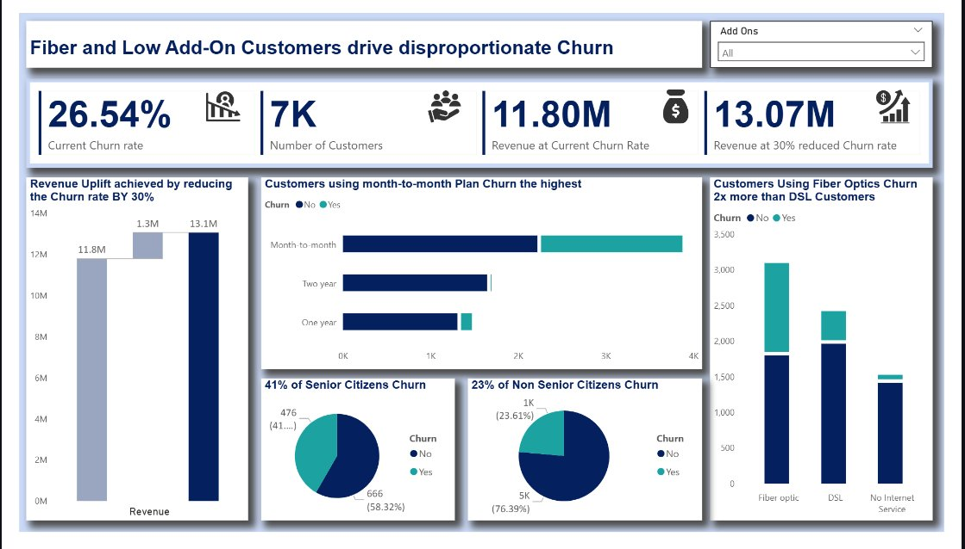
APPENDIX | POWER BI DASHBOARD
Interactive Power BI dashboard built to support executive decision-making
Dashboard includes Add-Ons slicer, KPI cards, revenue waterfall, contract-type breakdowns, and demographic churn splits
Telecom Churn Analysis | Harsh Anvekar | 2025

